Slide 1
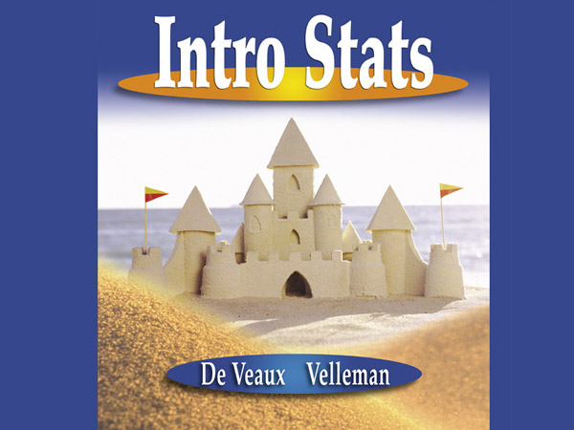

Slide 2

Sample Surveys
Chapter 12
Created by Jackie Miller, The Ohio State University

Slide 3
Background
We have learned ways to display, describe, and summarize data, but have been limited to examining the particular batch of data we have.
We’d like (and often need) to stretch beyond the data at hand to the world at large.
Let’s investigate three major ideas that will allow us to make this stretch…

Slide 4
Idea 1: Examine a Part of the Whole
The first idea is to draw a sample. We’d like to know about an entire population of individuals, but examining all of them is usually impractical if not impossible. So we settle for examining a smaller group of individuals—a sample—selected from the population.
Sampling is a natural thing to do. Think about sampling something you are cooking—you taste (examine) a small part of what you’re cooking to get an idea about the dish as a whole.

Slide 5
Examining Part of the Whole (cont.)
It’s hard to go a day without hearing about the latest opinion poll. These polls are examples of sample surveys, designed to ask questions of a small group of people in the hope of learning something about the entire population.
Pollsters take great care to query a sample that is representative of the population.

Slide 6
Examining Part of the Whole (cont.)
A sample that does not represent the population in some important way, such as one that overlooks an important group, is said to be biased. Bias is the bane of sampling—the one thing above all to avoid.
The best way to avoid bias is to select individuals for the sample at random. The value of deliberately introducing randomness is one of the great insights of Statistics.

Slide 7
Idea 2: Randomize
Randomization can protect you against factors that you know are in the data. It can also help protect against factors you are not even aware of.
By randomizing, we are protected from the influences of all the features of our population, even ones that we may not have thought about. It does that by making sure that on the average the sample looks like the rest of the population.

Slide 8
Randomizing (cont.)
Not only does randomizing protect us from bias, it actually makes it possible for us to draw inferences about the population when we see only a sample.
Such inferences are among the most powerful things we can do with Statistics.
But remember, it’s all made possible because we deliberately choose things randomly.

Slide 9
Idea 3: It’s the Sample Size
How large a random sample do we need for the sample to be reasonably representative of the population?
It’s the size of the sample, not the size of the population, that makes the difference in sampling. (Exception: If the population is small enough and the sample is more than 10% of the whole population, the population size can matter.)

Slide 10
Does a Census Make Sense?
Why bother determining the right sample size? Wouldn’t it be better to just include everyone and “sample” the entire population? Such a special sample is called a census.

Slide 11
Does a Census Make Sense? (cont.)
There are problems with taking a census:
  It can be difficult to complete a census—there always seem to be some individuals who are hard to locate or hard to measure.
  Populations rarely stand still. Even if you could take a census, the population changes while you work, so it’s never possible to get a perfect measure.
  Taking a census may be more complex than sampling.

Slide 12
Populations and Parameters
A parameter that is part of a model for a population is called a population parameter.
We use data to estimate population parameters. Any summary found from the data is a statistic. The statistics that estimate population parameters are called sample statistics.

Slide 13
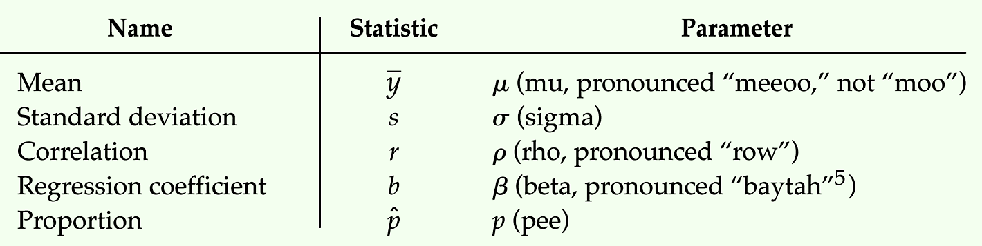
Notation
We use Greek letters to denote parameters and Latin letters to denote statistics.

Slide 14
Simple Random Samples
We need to be sure that the statistics we compute from the sample reflect the corresponding parameters accurately. A sample that does this is said to be representative.
We will insist that every possible sample of the size we plan to draw has an equal chance to be selected. Such samples also guarantee that each individual has an equal chance of being selected.
A sample drawn in this way is called a Simple Random Sample (SRS).

Slide 15
Simple Random Samples (cont.)
To select a sample at random, we first need to define where the sample will come from. The sampling frame is a list of individuals from which the sample is drawn.
Once we have our sampling frame, the easiest way to choose an SRS is with random numbers.
When we draw a sample at random, each sample we draw will be different. We call these sample-to-sample differences sampling variability.

Slide 16
Other Sampling Designs
There are other fair ways to sample besides taking an SRS. Regardless of the design, all statistical sampling designs have in common the idea that chance, rather than human choice, is used to select the sample.
Other designs include: stratified random sampling, cluster sampling, multistage sampling, and systematic sampling.

Slide 17
Other Sampling Designs (cont.)
Designs that are used to sample from large populations are often more complicated than simple random samples.
Sometimes the population is first split up into homogeneous groups, called strata, before the sample is selected. Then an SRS is taken within each stratum before the results are combined. This is the essence of stratified random sampling.

Slide 18
Other Sampling Designs (cont.)
Sometimes selecting a group, or cluster, of individuals and then randomly sampling within each cluster is the best sampling method available to us. This is called cluster sampling.
Many surveys use some combination of stratified and cluster sampling as well as SRSs. Sampling schemes that combine these methods are called multistage samples.

Slide 19
Systematic Samples
Sometimes we draw a sample by selecting individuals systematically. For example, you might survey every 10th person on an alphabetical list of students.
To make it random, you must still start the systematic selection from a randomly selected individual.
When there is no reason to believe that the order of the list could be associated in any way with the responses sought, systematic sampling can give a representative sample.

Slide 20
Who’s Who?
The Who of a survey can refer to different groups, and the resulting ambiguity can tell you a lot about the success of a study.
To start, you should think about the population of interest. Often, you’ll find that this is not really a well-defined group.
Second, you must specify the sampling frame. The sampling frame limits what your survey can find out.

Slide 21
Who’s Who? (cont.)
Then, there’s the sample itself. These are the individuals for whom we intend to measure responses. We may not even succeed with all of them. Nonresponse is a problem in many surveys.
Finally, there are the actual respondents. These are the individuals about whom we can get data and draw conclusions. Unfortunately, they might not be representative of the sample, the sampling frame, or the population.

Slide 22
Who’s Who? (cont.)
A careful study should address the question of how well each group matches the population of interest.
One of the main benefits of simple random sampling is that it never loses its sense of who’s Who. The Who in an SRS is the population of interest from which we’ve drawn a representative sample. (That’s not always true for other kinds of samples.)

Slide 23
What Can Go Wrong?—or,
How to Sample Badly
Sample Badly with Volunteers:
  In a voluntary response sample, a large group of individuals is invited to respond, and all who do respond are counted. Voluntary response samples are almost always biased toward those with strong opinions or those who are strongly motivated.
  Since the sample is not representative, the resulting voluntary response bias invalidates the survey.

Slide 24
What Can Go Wrong?—or,
How to Sample Badly (cont.)
Sample Badly, but Conveniently:
  In convenience sampling, we simply include the individuals who are at hand. Unfortunately, this group may not be representative of the population.
Sample from a Bad Sampling Frame:
  An SRS from an incomplete sampling frame introduces bias because the individuals included may differ from the ones not in the frame.

Slide 25
What Can Go Wrong?—or,
How to Sample Badly (cont.)
Undercoverage:
  Many of these bad survey designs suffer from undercoverage, in which some portion of the population is not sampled at all or has a smaller representation in the sample than it has in the population.

Slide 26
What Else Can Go Wrong?
Watch out for nonrespondents—a common and serious potential source of bias for most surveys is nonresponse bias. No survey succeeds in getting responses from everyone. The problem is that those who don’t respond may differ from those who do.
Don’t bore respondents with surveys that go on and on and on and on…

Slide 27
What Else Can Go Wrong? (cont.)
Work hard to avoid influencing responses—response bias refers to anything in the survey design that influences the responses. For example, the wording of a question can influence the responses.

Slide 28
How to Think About Biases
Look for biases in any survey you encounter—there’s no way to recover from a biased sample of a survey that asks biased questions.
Spend your time and resources reducing biases.
If you possibly can, pretest your survey.
Always report your sampling methods in detail.

Slide 29
So What Do We Know?
We try to estimate population parameters with sample statistics, so we want our sample to be as representative of the population as possible.
There are good (and, unfortunately, bad) ways to sample. Good sampling designs always include randomization.
Watch out for biases that may occur in your sampling design or your responses.

